Slide 1
Predicting Stock Market Trends Using Advanced Machine Learning Techniques
Names:

Slide 2
Introduction
Objective:
The primary aim of this study is to evaluate and compare the forecasting accuracy of ARIMA and LSTM models for stock prices. By doing so, we seek to determine which model offers better performance in predicting stock price movements and can be more reliable for financial forecasting.
Stocks Analysed:
Our analysis focuses on three prominent stocks: Apple Inc. (AAPL), known for its tech innovations; Microsoft Corporation (MSFT), a leading software and hardware giant; and Alphabet Inc. (GOOGL), the parent company of Google. These stocks represent diverse sectors and behaviors in the market.
Evaluation Metrics:
We use Mean Absolute Error (MAE) to measure the average magnitude of errors in predictions, providing insight into model accuracy. Additionally, Root Mean Squared Error (RMSE) is used to assess the magnitude of prediction errors, particularly penalizing larger deviations to highlight model precision.

Slide 3
Data Overview
Data Sources:
Historical stock price data was obtained from reputable financial platforms such as Yahoo Finance and Google Finance. These sources provide comprehensive and reliable datasets crucial for accurate forecasting and model evaluation.
Data Period:
The dataset covers a specified time period, for example, from January 2010 to December 2023. This extensive timeframe ensures a thorough analysis, capturing various market conditions and trends relevant to the stock price forecasting.
Features:
The data includes essential features: Date, Open Price, High Price, Low Price, Close Price, and Volume. These variables are integral for analyzing stock price behavior and for training and evaluating forecasting models.
Data Size:
The dataset comprises a substantial number of records, with data points typically recorded daily or weekly. This frequency and volume of data provide a robust basis for accurate model training and evaluation.

Slide 4
ARIMA Model
Description:
ARIMA stands for AutoRegressive Integrated Moving Average.
Used for time series forecasting by capturing temporal dependencies.
Model Components:
AR (AutoRegressive) term: Captures the relationship between an observation and several lagged observations.
I (Integrated) term: Represents differencing to make the time series stationary.
MA (Moving Average) term: Models the relationship between an observation and a residual error from a moving average model.
Key Parameters:
p: Number of lag observations included (lag order).
d: Number of times that the raw observations are differenced (degree of differencing).
q: Size of the moving average window (order of moving average).

Slide 5
LSTM Model
Description:
Long Short-Term Memory (LSTM) is a type of Recurrent Neural Network (RNN) designed to model sequential data.
Capable of learning long-term dependencies and patterns in data.
Model Components:
Memory Cells: Stores information over long periods.
Gates: Control the flow of information (input gate, forget gate, output gate).
Key Parameters:
Number of Layers: Determines the depth of the network.
Units per Layer: Number of neurons in each layer.
Activation Functions: Functions like ReLU or tanh used to introduce non-linearity.

Slide 6
Methodology
Data Preparation:
Splitting: Dividing data into training, validation, and test sets.
Normalization: Scaling data to a range suitable for model training (e.g., Min-Max scaling).
Preprocessing: Handling missing values, outliers, and feature engineering.
Model Training:
ARIMA: Fitting the ARIMA model using historical data, optimizing parameters.
LSTM: Training the LSTM model with sequences of data, tuning hyperparameters.
Evaluation Metrics:
MAE (Mean Absolute Error): Measures the average magnitude of errors in predictions, without considering their direction.
RMSE (Root Mean Squared Error): Measures the square root of the average of squared errors, giving higher weight to larger errors.

Slide 7
Performance Metrics Overview
MAE:
Definition: Average of absolute differences between predicted and actual values.
Interpretation: Lower MAE indicates better model accuracy.
RMSE:
Definition: Square root of the average of squared differences between predicted and actual values.
Interpretation: Lower RMSE indicates better model performance, with emphasis on larger errors.

Slide 8
Results - AAPL Stock
Table I: Model Performance for AAPL
Model | MAE | RMSE
ARIMA | 11.49 | 13.55
LSTM | 4.11 | 5.18
Key Findings:
LSTM: Significantly lower MAE and RMSE compared to ARIMA.
Interpretation: LSTM provides a more accurate forecast for AAPL stock prices.

Slide 9
Results - MSFT Stock
Table II: Model Performance for MSFT
Key Findings:
ARIMA: Lower MAE and RMSE compared to LSTM.
Interpretation: ARIMA provides a more accurate forecast for MSFT stock prices.
Model | MAE | RMSE
ARIMA | 6.24 | 8.19
LSTM | 31.87 | 33.65

Slide 10
Results - GOOGL Stock
Table III: Model Performance for GOOGL
Key Findings:
ARIMA: Superior performance compared to LSTM.
Interpretation: ARIMA offers better forecasting accuracy for GOOGL.
Model | MAE | RMSE
ARIMA | 5.86 | 7.18
LSTM | 8.08 | 9.22

Slide 11
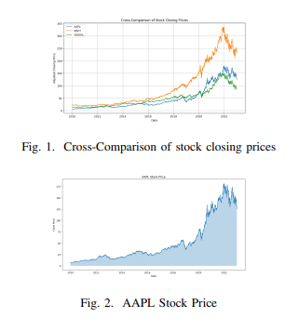
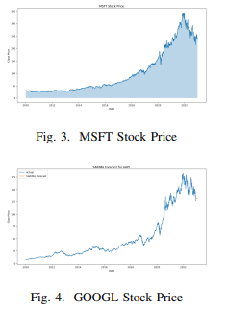
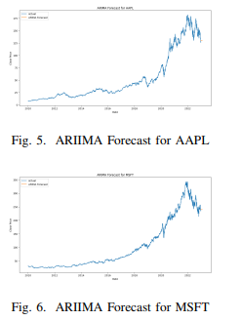
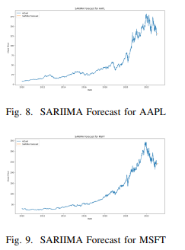
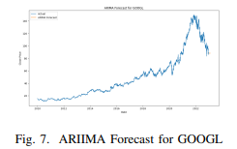
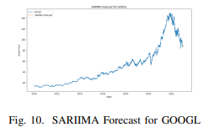
Visualization of AAPL, MSFT, GOOGL

Slide 12
Summary of Results
Overall Findings:
AAPL: LSTM shows superior performance with lower MAE and RMSE.
MSFT: ARIMA outperforms LSTM with better MAE and RMSE.
GOOGL: ARIMA is more accurate than LSTM based on performance metrics.
Visuals:
Comparative Charts: Combine bar charts of MAE and RMSE for AAPL, MSFT, and GOOGL.
Insights: Discuss the implications of the results and potential reasons behind the varying performances.

Slide 13
Conclusion and Future Work
Conclusion:
Key Takeaways: ARIMA and LSTM have distinct strengths depending on the stock analyzed.
Implications: Choice of model should consider the specific stock and performance metrics.
Future Work:
Model Exploration: Test other forecasting models and hybrid approaches.
Data Enhancements: Incorporate additional features and longer time periods.
Research Opportunities: Investigate model performance in different market conditions or with more granular data.

Slide 14
Thank You!
Contact Information: [Your Email Address]
Questions? Invite audience to ask questions or provide feedback.

